Slide 1
Session 1

Slide 2
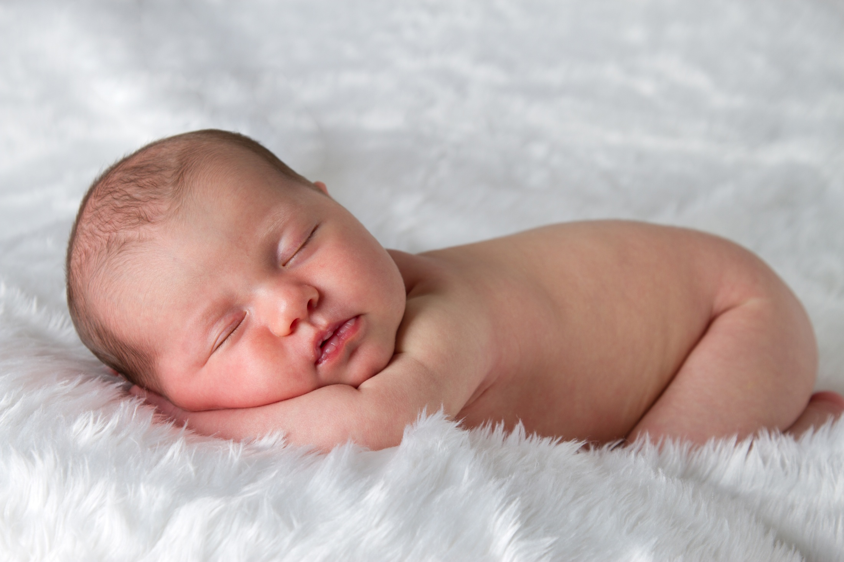

Slide 3
Jeremiah 1:5 Before I formed you in the womb I knew you, before you were born I set you apart; I appointed you as a prophet to the nations.

Slide 4
Session 2

Slide 5
Matthew 10:30 And even the hairs on your head are numbered.

Slide 6
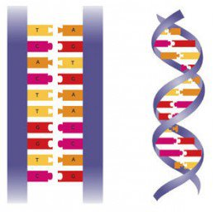

Slide 8
John 10:3 The watchman opens the gate for him, and the sheep listen to his voice. He calls his own sheep by name and leads them out

Slide 9
Matthew 10:30 And even the hairs on your head are numbered.

Slide 10
John 10:3 The watchman opens the gate for him, and the sheep listen to his voice. He calls his own sheep by name and leads them out

Slide 11
Session 3

Slide 13
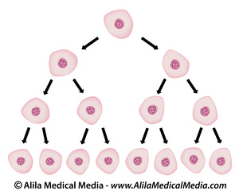

Slide 15
Psalm 139:13-14 For you created my inmost being; you knit me together in my mother’s womb. I praise you because I am fearfully and wonderfully made; your works are wonderful, I know that full well.

Slide 17
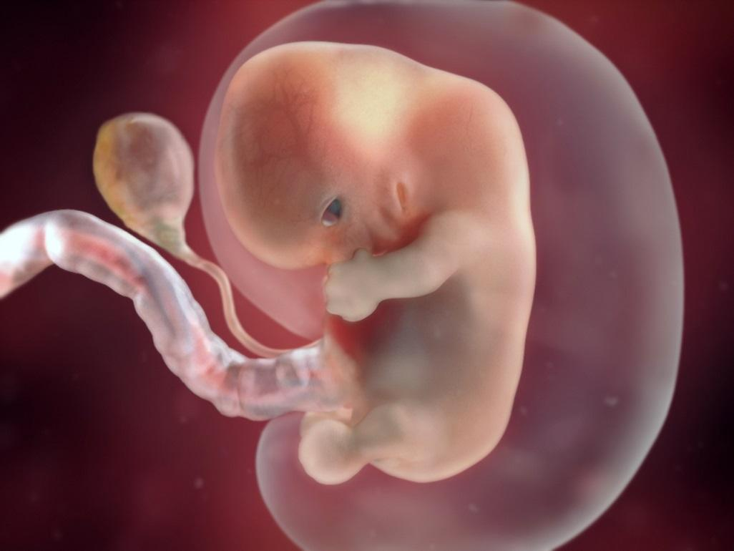

Slide 18
Psalm 139:13-14 For you created my inmost being; you knit me together in my mother’s womb. I praise you because I am fearfully and wonderfully made; your works are wonderful, I know that full well.

Slide 20
Session 4

Slide 21
Genesis 2:7 The Lord God formed the man from the dust of the ground and breathed into his nostrils the breath of life, and the man became a living being.

Slide 22
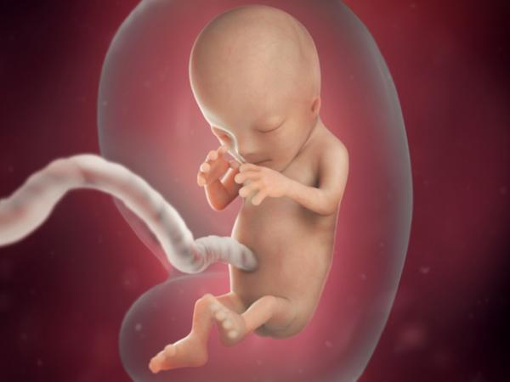

Slide 23
Genesis 2:7 The Lord God formed the man from the dust of the ground and breathed into his nostrils the breath of life, and the man became a living being.

Slide 25
Session 5

Slide 26
Colossians 1:17 He is before all things, and in him all things hold together..

Slide 27
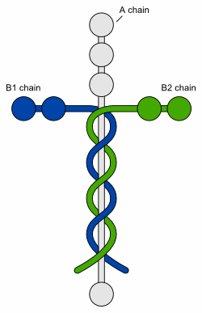

Slide 28
